Slide 1


Exploratory Analysis:
Netflix Movies and TV Shows
March 24, 2020
* Harini Rao
* Neelam Baxi
* Veronica Ratcliff
* Zen Acar
Notes:
Image Sources:
https://www.vectorstock.com/royalty-free-vector/black-retro-movie-camera-on-a-tripod-vector-21866312
https://www.dafont.com/forum/read/193000/new-netflix-logo-font
https://becominghuman.ai/how-netflix-uses-ai-and-machine-learning-a087614630fe

Slide 2
Motivation and Summary
Spread of COVID-19, social distancing, best source of entertainment
Daily use of Netflix
Dataset source used:
Netflix - Kaggle: https://www.kaggle.com/shivamb/netflix-shows
Female Directors List - IMDB: https://www.imdb.com/list/ls027192075/
Deep dive into Netflix content
Representation of Female Directors on Netflix
Notes:
We find ourselves turning on our TVs and selecting the Netflix app on a daily basis, especially now that we are all home more than ever. We were interested in exploring a Netflix dataset to see what content Netflix has added over the past 11 years (2008- 2019). Due to the spread of COVID-19, everyone across the Globe is either working from home or trying to entertain their kids and the best source for entertainment, TV/Internet.
Dataset source used:
Netflix - Kaggle: https://www.kaggle.com/shivamb/netflix-shows
Female Directors List - IMDB: https://www.imdb.com/list/ls027192075/
Our group wanted to take a deep dive into Netflix and explore what content it offers and what countries have produced content represented on Netflix? Additionally, as women we were interested in exploring how Female Directors are represented on Netflix. As we explored, more questions arose.

Slide 3
What Questions we asked of Data:
Distribution of Content:
How many Movies/TV Shows have been added on Netflix in the past 11 years?
Growth of type of content over the years
What is the correlation of between Movie release year and year added on Netflix?
What is the geographical distribution of content by type?
Who are the top Movie and TV Show directors on Netflix, how many are women?
Genre / Ratings:
Which are the top 10 genres of Movies and TV Shows on Netflix?
What genre of Movies do Females direct?
How is the content categorized?
Duration:
What is the duration of Movies based on the Movie ratings?
Has the time of Movie Duration reduced over the period of time?
What is the average duration of Movies based on genre?
What is the most common duration of Movies Females direct?
Notes:
Brief Description of the Pointers above:
Highlight few countries while speaking about it.

Slide 4
Data Cleanup & Exploration
1) Exploration and cleanup process:
a) Formatted the date column
b) Added a new column for Year added
c) Split up the Genre (Main and Sub Category)
d) Split up the Director column
e) Converted the Duration column
f) Removed unnecessary columns on Female Directors dataset
g) Added gender column, assigning the gender to directors
2) Challenges that arose and resolutions:
a) Splitting the country column
b) Merging the Female Directors dataset with Netflix dataset
3) Interesting figures developed during exploration:
a) Learnt some new visual representations - World map, Tornado plot, Wordcloud
Notes:
We first defined the section/categories of our datasets. After that we took a deep dive and looked closer to what questions can be asked into those sections/categories and conducted our analysis.
Challenges & resolutions:
splitting the country column
Merging the Female Directors dataset with Netflix dataset: it was not a 1:1 relationship of columns, and the dataset was unclean. Resolution: cleaned up the dataset by adding a gender column and removing unnecessary columns that were not required and splitting the director column in the netflix dataset as it had multiple directors

Slide 5
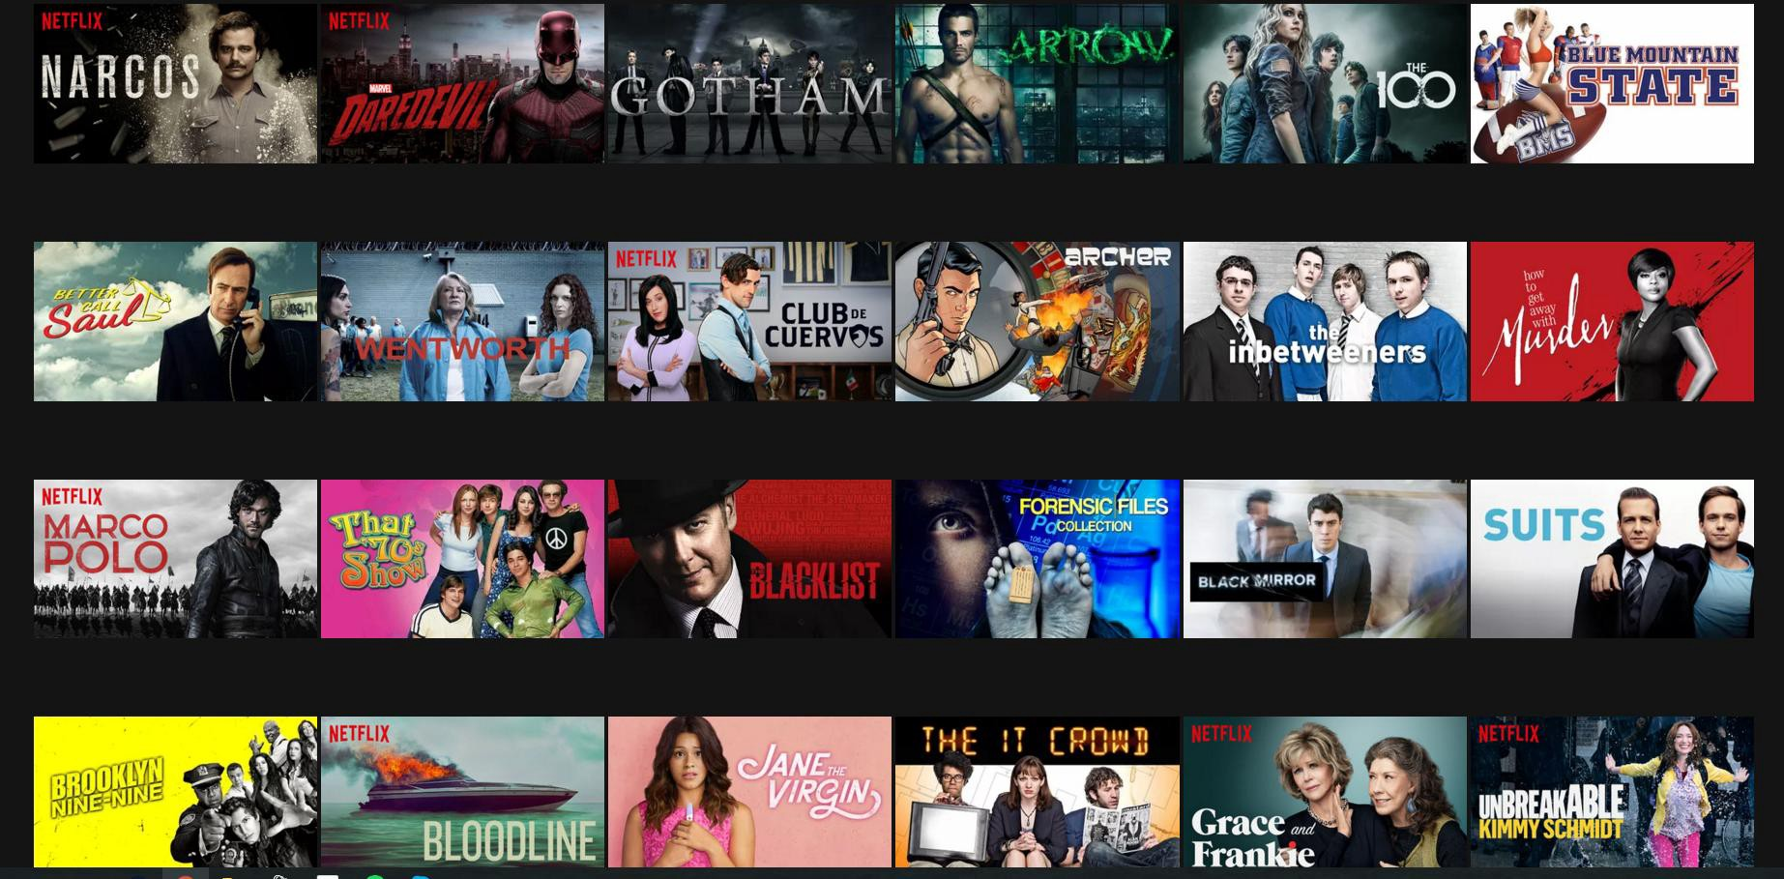
Data Analysis
Let’s move onto detailed Data Analysis and Visualization of our datasets

Slide 6
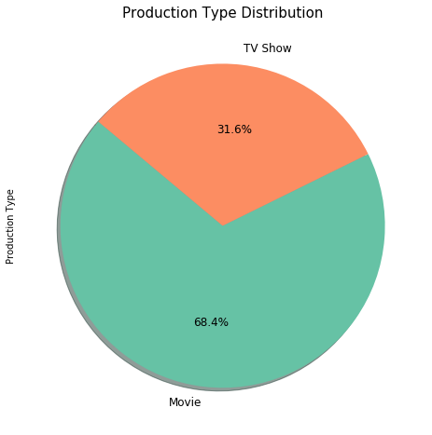
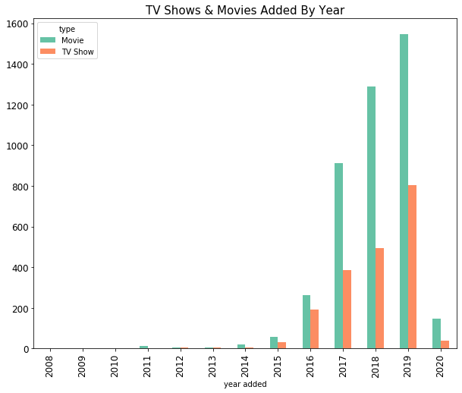
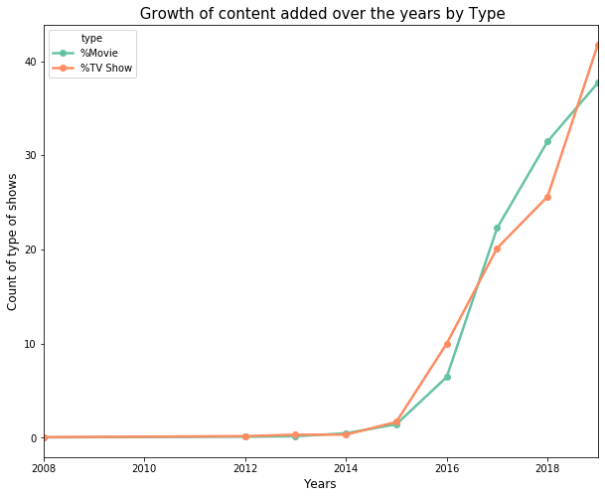
Distribution of Movies/TV Shows added on Netflix
Overview of percentage distribution of Movie versus TV Shows on Netflix from 2008-2020. 68.4% of content on Netflix is Movies while TV Shows make up 31.6%.
Netflix has seen a tremendous growth in past 11 years.
In the past 2 years there has been a shift in percentage of content type added.

Slide 7
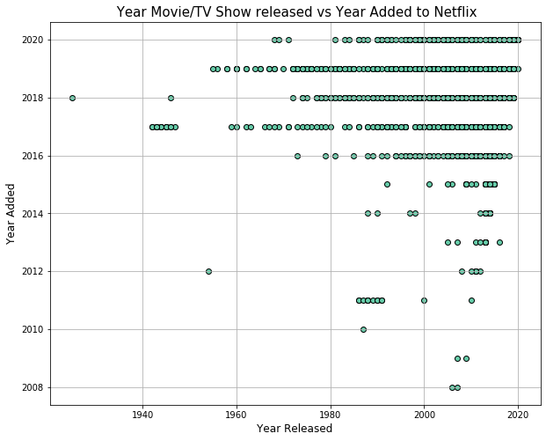
Correlation of Content between the Release year and Year added on Netflix
The correlation between release year and year added to Netflix is 0.02 which indicates less to no correlation.
Some of the Movies/TV Shows that were released in between 1980 to 2000 weren’t added to Netflix until 2011 whereas Movie/TV Show that was released and added in the same year.
Notes:
The data could be skewed and for further analysis we could’ve looked at only recent years.

Slide 8
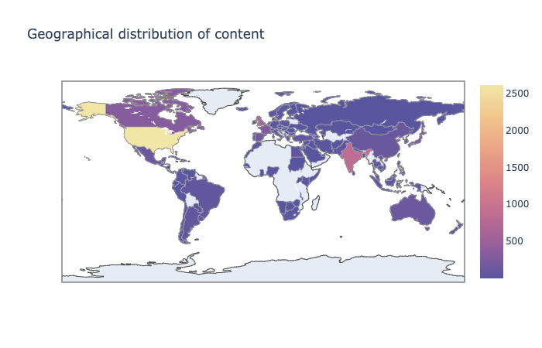
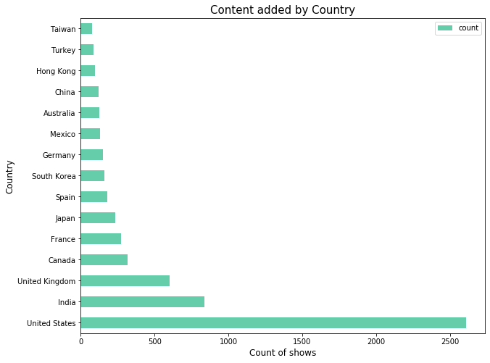
Geographical Distribution of Content
United States looks to be the trailblazer in content production, with over 2600 total content titles followed closely by India( with 838 total titles) and the United Kingdom (with 601 total titles).

Slide 9
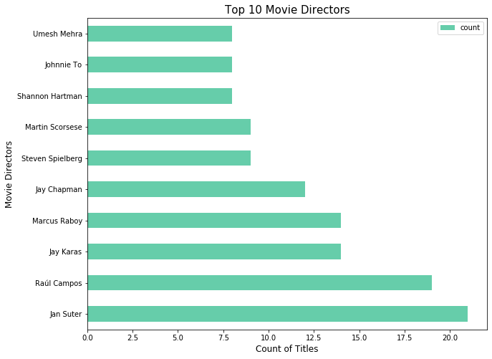
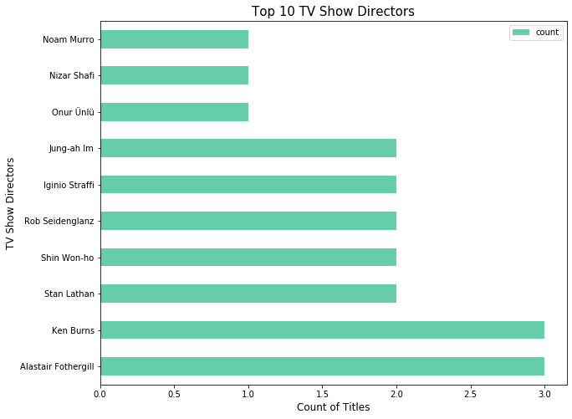
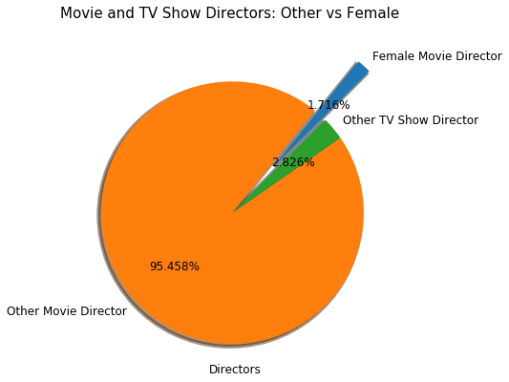
Movies/TV Shows Directors
Most number of Movies on netflix were directed by Jan Suter
Most number of TV Shows on Netflix were directed by Alastair Fothergill and Ken Burns
Female Directors only comprise 1.7% of the total number of Directors of Movies and TV shows.
We see that Female directors haven't directed any TV Shows solely.

Slide 10
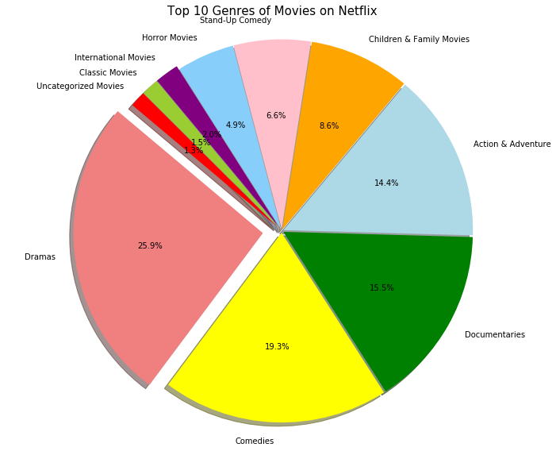
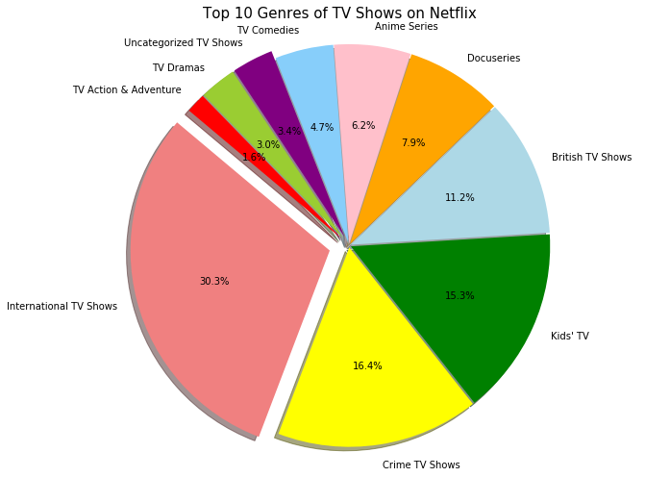
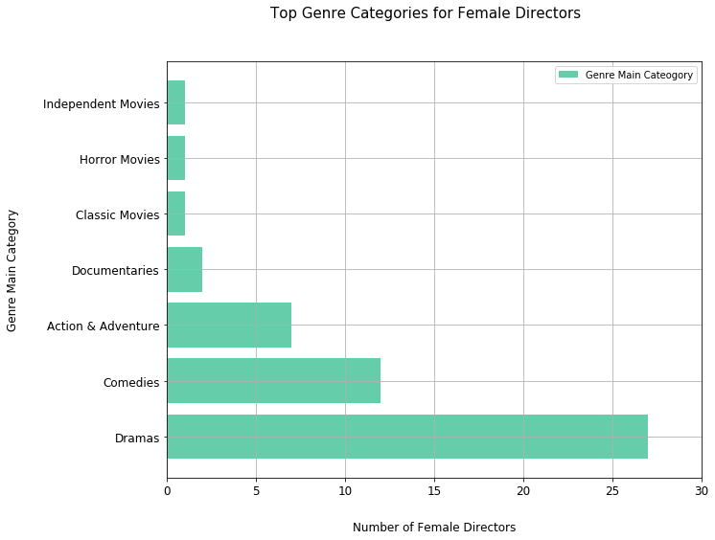
Movies/TV Shows Genres
The most common Genre of Movies is ‘Dramas’.
The most common Genre of TV Shows is ‘International TV Shows’.
Female directors are most likely to direct Movies that are dramatic.

Slide 11
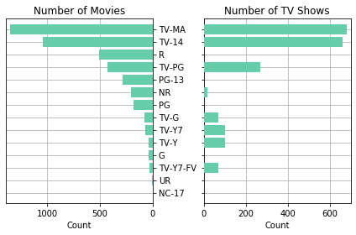
Movies/TV Shows Ratings
Most content offered within Netflix is Rated TV-MA, TV-14, R, TV-PG, and PG-13.

Slide 12
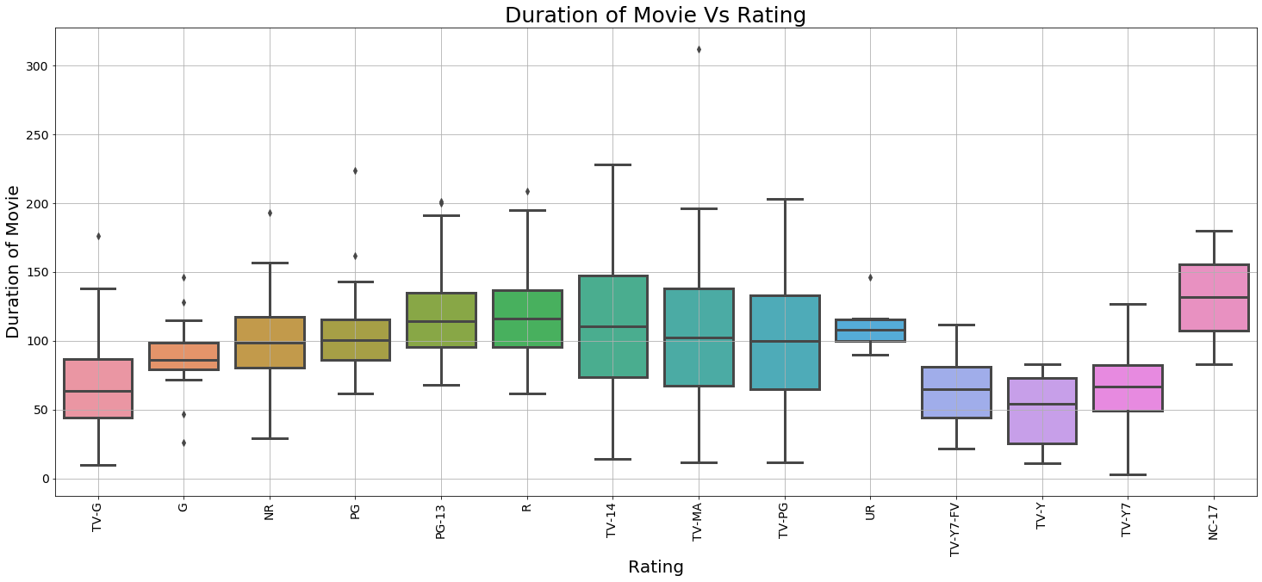
Movie Duration vs Rating
Movies with the ratings TV-MA and TV-14 seem to be of the longest duration possibly suggesting age of the audience and duration of the movies might be related.

Slide 13
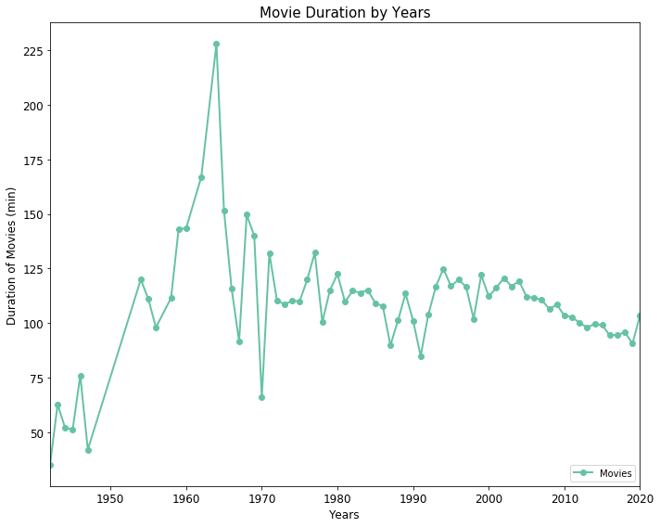
Duration of Movies
Much variation observed in the length of the movies till the 1980s.
From 2000s, average duration decreased approximately by 30% from 1960s.

Slide 14
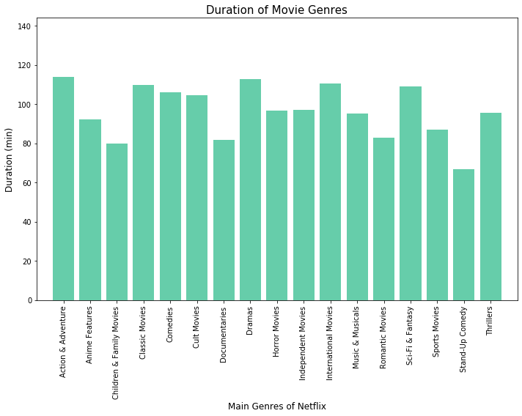
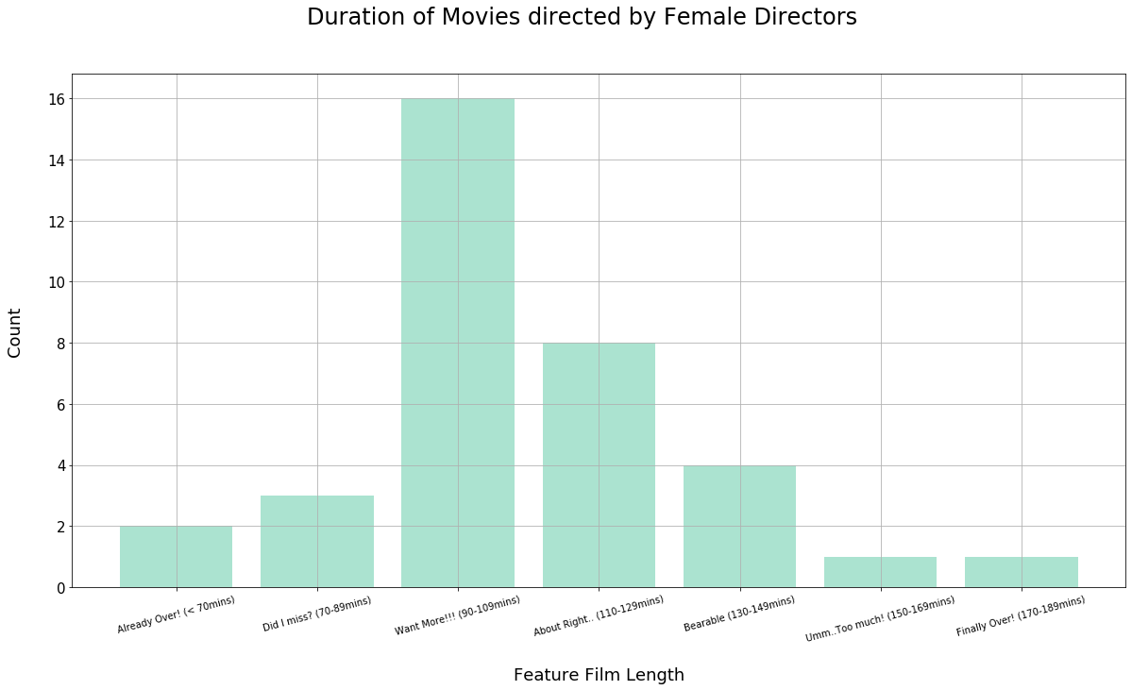
Movies/TV Shows Duration based on Genres and Female Directors
Classic movies, Dramas and International movies have the longest durations.
Children & Family movies, Documentaries and Stand-up Comedies have the shortest durations.
Female Directors have directed more movies in the Want More category of duration from 70 to 90 mins.

Slide 15
Satisfaction / Further Analysis:
We are satisfied with the answers to the questions we asked on our datasets.
Additional questions :
If we had 2 more weeks we could have:
Identified Datasets with more numerical values to explore:
Viewers/membership statistics
Ratings (based on popularity)
Added more recent data from Flixable (search engine for Netflix content) or RapidAPI
Researched more diverse data based on gender- for directors, actors and regions
Compared data from other streaming services/platforms.

Slide 16
Conclusions/Insights:
Netflix continues to increase its content. Based on the trend, it will be higher in 2020 compared with 2019.
The percentage of content added from 2018 to 2019 is higher for TV Shows opposed to Movies
The genre ‘Dramas’ of Movies has the most content and is also most preferred by Female Directors. It is also amongst the top 3 longest duration Movies genre.
The majority of the content is for mature audience (TV-MA) or audience with ages 14 and above (TV-14).
Female directors represent only 1.7% of the total number of directors.
International TV being the highest count of TV Show offerings amongst all genre types.
The number of Movies and TV Shows added by United Kingdom are approximately the same as opposed to the top 2 content producers.

Slide 17
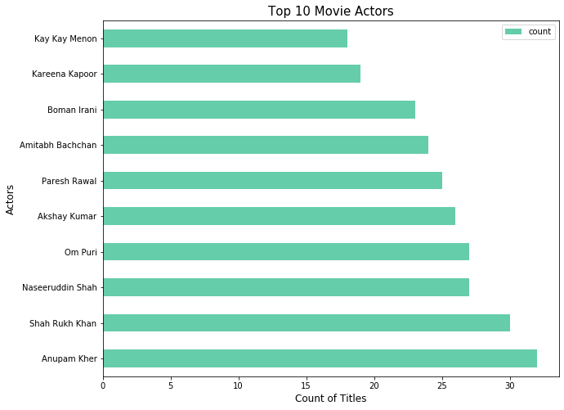
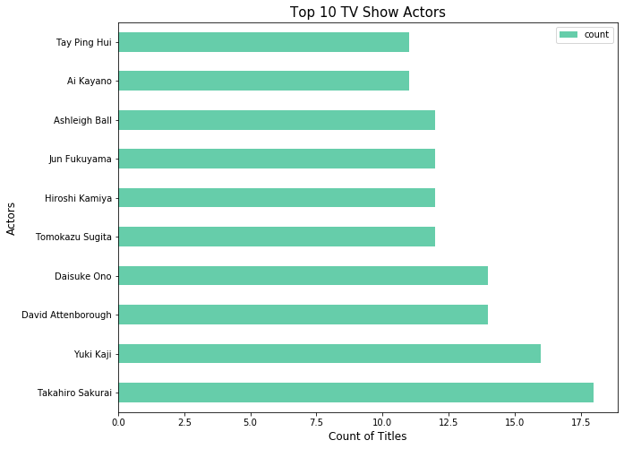
Fun Findings:
The actors with most number of Movie titles are from India.

Slide 18
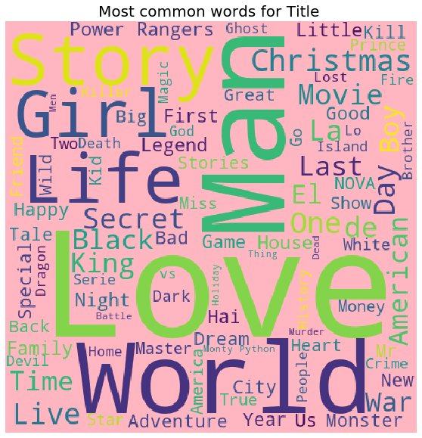

Slide 19
Any Questions???

